Slide 1
Lecture 20: Machine Translation: Phrase-Based Translation and Decoding
USC VSoE CSCI 544: Applied Natural Language Processing
Jonathan May -- 梅約納
November 8, 2017
slides from Philipp Koehn

Slide 2
Where Are We So Far?
We know how to evaluate a machine translation output (BLEU, e.g.)
We know how to find word alignments and conditional word translation probabilities from a parallel corpus (IBM Models, EM = GIZA++)
How might we actually translate a never-before-seen sentence?
Today/Friday:
Phrase extraction from word alignments
Decoding
Features
Tuning

Slide 3
Why Phrases?
 | natuerlich | hat | john | spass | am | spiel
of | x
course | x
john |  |  | x
has |  | x
fun |  |  |  | x
with |  |  |  |  | x
the |  |  |  |  | x
game |  |  |  |  |  | x
The relationship between words in a sentence pair is many-to-many
So we translate phrases as atomic units instead of words
If you have seen a long phrase before and you know how it was translated, best to just use it rather try to recreate it from scratch!

Slide 8
How To Get Phrases and probabilities?
Get word alignments (see last lecture)
Extraction algorithm (see next slides)
Maximum likelihood estimate for p(f_{phrase}|e_{phrase}) (see most of the previous lectures in this class)

Slide 9
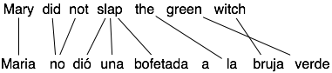
Extract phrase pairs from each sentence
Maria no dió una bofetada a la bruja verde
Alternate
Representations
Mary
did
not
slap
the
green
witch
(Koehn et al. ’03)

Slide 10
Rule Extraction: Phrase Pairs
Find contiguous blocks that respect alignment
A block can’t contain a word that is aligned outside that block
Good
Bad
(dió una bofetada, slap)
Mary
did
not
slap
the
green
witch
(no, did)
Maria no dió una bofetada a la bruja verde
Good
(Maria, Mary)
Mary
did
not
slap
the
green
witch
Good
(no, did not)
Bad
(no dió, not)
Bad
(dió una, slap)

Slide 11
Rule Extraction: Phrase Pairs
KK
Find contiguous blocks that respect alignment
Maria no dió una bofetada a la bruja verde
Mary
did
not
slap
the
green
witch

Slide 12
Rule Extraction: Phrase Pairs
KK
Find contiguous blocks that respect alignment
Maria no dió una bofetada a la bruja verde
Mary
did
not
slap
the
green
witch
Smallest phrase pairs
Join adjacent pairs
Cover unaligned words
etc.
etc.
etc.

Slide 13
Extraction Algorithm
OK
X
VIOLATION
OK
Another Example
Propose a pair
Look at adjacent blocks for violators
OK

Slide 14
Extraction Algorithm
OK
OK
OK
Another Example
Propose a pair
Look at adjacent blocks for violators
assumes that <-> geht davon aus , dass
OK

Slide 19
Quiz
When is PMI of a word w and its context c = 0 (choose all that apply)?
When the joint probability of observing w and c is independent of the probability of each individual event
When p(w,c) < p(w)p(c)
When p(w,c) = p(w)p(c)
Never
When p(w, c) > p(w)p(c)

Slide 29
Decoder State
Reminder: we have two desires in producing quality MT output:
Adequacy: We faithfully translate the meaning of the input
Fluency: The output is a coherent English sentence
We have two probability models to help us make these decisions
e_{best} = argmax_{e}Pr(e|f) = argmax_{e}Pr(e)Pr(f|e)
Phrase-based MT decoding is equivalent to wFSA traversal
state must remember n-1 e words in order to have an n-gram LM
state must remember which f-words have been translated so we cover them all exactly once

Slide 33
final hypothesis reached when all input words are covered (adequacy)

Slide 40
Two Types of Error
There are, broadly speaking, two things that go wrong when translating
Your system gives you a bad translation (low BLEU) that it thinks is good. This is called model error. To fix it, make your model better
Your system does not give you the best translation it knows (suboptimal model score). This is called search error. To fix it, fix the search (less pruning, fewer heuristics)

Slide 41
Demo
http://mt-class.org/jhu-2016/stack-decoder/
Note examples of model and search error

Slide 42

$$\operatorname{Pr}\left(f, a | e\right)= \frac{1}{Z}\prod_{i=1}^{m}{t(f_{i}|e_{a\left(i\right)})}$$

Slide 43
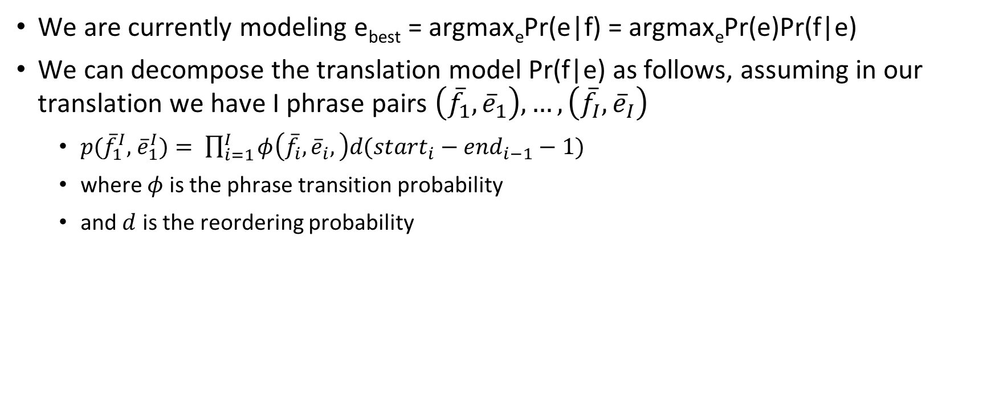
Influence decoder behavior with more features (improve the model)
We are currently modeling e_{best} = argmax_{e}Pr(e|f) = argmax_{e}Pr(e)Pr(f|e)
We can decompose the translation model Pr(f|e) as follows, assuming in our translation we have I phrase pairs $\left({\overline{f}}_{1},{\overline{e}}_{1}\right),…,\left({\overline{f}}_{I},{\overline{e}}_{I}\right)$
$p({\overline{f}}_{1}^{I},$ ${\overline{e}}_{1}^{I})= \prod_{i=1}^{I}{φ\left({\overline{f}}_{i},{\overline{e}}_{i},\right)d(start_{i}−end_{i−1}−1) }$
where $φ$ is the phrase transition probability
and $d$ is the reordering probability

Slide 47
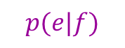
$$p(e|f)$$
+
Why limit ourselves to these three features?

Slide 48
phrase

Slide 50
From Generative to Discriminative
By saying "some models may be more important than others" we've taken a step from generative to discriminative models
Generative:
translation process broken down into steps
each step is modeled by a probability distribution
each distribution is estimated from data by maximum likelihood
overall question answered: "how did this data get here?"
Discriminative:
model has a number of features
each feature has some weight which measures its contribution to making a correct translation
features are optimized on some held-out development data so that system output matches correct translations as closely as possible

Slide 51
Rule Extraction: Phrase Pairs
KK
Bad phrase (violation above)
Maria no dió una bofetada a la bruja verde
Mary
did
not
slap
the
green
witch
X

Slide 52
Rule Extraction: Phrase Pairs
KK
Bad phrase (violation left)
Maria no dió una bofetada a la bruja verde
Mary
did
not
slap
the
green
witch
X
X

